Slide 1
CONVOLUTIONAL NEURAL NETWORKS FOR IMAGE CLASSIFICATION 700746936 POOJA BHAVANI AVUTHU

Slide 2
CONTENTS
ABSTRACT
MOTIVATION
OBJECTIVES
RELATED WORK
PROBLEM STATEMENT
PROPOSED SOLUTION
RESLUTS/SIMULATIONS
REFERENCES

Slide 3
ABSTRACT
Convolutional Neural Networks (CNNs) have emerged as a powerful tool for image classification tasks in recent years. Their ability to automatically learn hierarchical features from raw pixel data has led to significant advancements in various domains such as computer vision, medical imaging, and autonomous driving.
This PPT provides an overview of CNN architectures, starting from the basic building blocks like convolutional layers, pooling layers, and fully connected layers, to more advanced techniques such as residual connections, batch normalization, and transfer learning.
Moreover, we examine emerging trends and innovations in CNN research, such as attention mechanisms, capsule networks, and adversarial training, elucidating their potential to advance the state-of-the-art in image classification’.

Slide 4
MOTIVATION
Exploring Convolutional Neural Networks (CNNs) for image classification stems from the inherent complexity and richness of visual data and the need for automated and accurate methods to analyze and classify images across various domains. Here are several key motivations:
Complexity of Visual Data.
Explosion of Image Data
Potential for Innovation.
In summary, the motivation behind investigating CNNs for image classification lies in the need for robust, scalable, and automated solutions to analyze visual data across diverse applications, leveraging the power of deep learning to address the complexities inherent in images.

Slide 5
OBJECTIVES
Detailed Examination of Architectures
Training Techniques and Challenges
Performance Evaluation
Comparison with Baseline Methods
Overall, the main contributions and objectives is to provide researchers with a comprehensive understanding of CNNs for image classification, fostering further innovation and application of deep learning in this critical domain.

Slide 6
RELATED WORK
The objective of this part is to build an algorithm that can identify photographs of cats and dogs. To create predictions, it examines input photographs of dogs and cats. The implemented model can be adjusted for mobile devices or websites.
The image will show a dog if the likelihood is more than 0.5, else a cat.

Slide 7
PROBLEM STATEMENT
We start with understanding the dataset used for training. And classify them as cat and dog so that we can segregate the data for model to learn. We have species information for dataset in this block such as the split ratio and image size. Next, we focused on Data preparation where we do the following processes:
Read image from data less.
Resize it so that features can be extracted later.
Convert image from string type to float.
Append processed image along with the label.

Slide 8
PROPOSED SOLUTION
We ran the model multiple time to understand how the accuracy and loss rate is affected by the changes we make.
As we increase the layers of Convolution, epochs and no. of images to train we can see the accuracy increasing.
As we can see in the last rows for 10,000 and 15,000 images the model seems to be overfitting as the training accuracy is increasing linearly over time, whereas validation accuracy stalls around 81%-90% in the training process.
Also, the difference in accuracy between training and validation accuracy is noticeably a sign of overfitting.

Slide 9
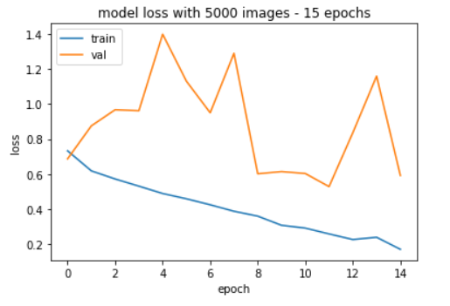
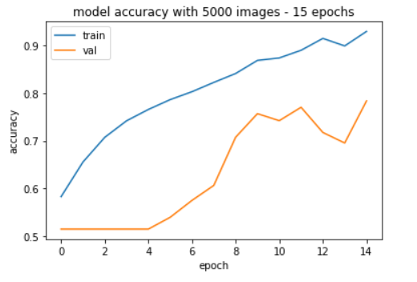
RESULTS

Slide 10
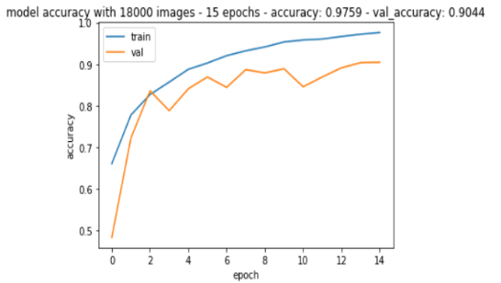
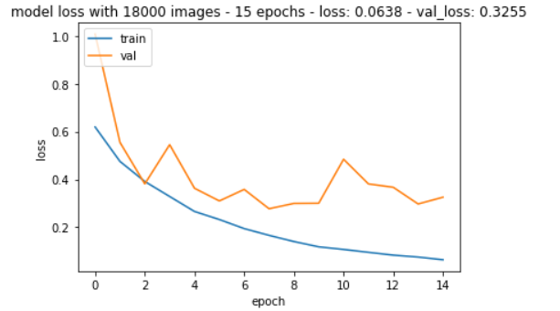
RESULTS

Slide 11

CONCLUSION
Convolutional Neural Networks (CNNs) have revolutionized the field of image classification, demonstrating remarkable performance in various tasks.
Their hierarchical architecture, which includes convolutional, pooling, and fully connected layers, allows them to automatically learn meaningful features from raw pixel data, eliminating the need for handcrafted feature extraction.

Slide 12
REFERENCE
[1] Hongchun Lu, Min Han, Chaoqing Wang, Junlong Cheng, "AMLNet: Attention Multibranch Loss CNN Models for Fine-Grained Vehicle Recognition", IEEE Transactions on Vehicular Technology, vol.73, no.1, pp.375-384, 2024.
[2] Sha Lu, Kaixing Wu, Jinxin Chen, "Solar Cell Surface Defect Detection Based on Optimized YOLOv5", IEEE Access, vol.11, pp.71026-71036, 2023.
[3] Feiyang Li, Jiangtao Wang, "Remote Sensing Image Scene Classification via Regional Growth-Based Key Area Fine Location and Multilayer Feature Fusion", IEEE Geoscience and Remote Sensing Letters, vol.20, pp.1-5, 2023.
[4] Xu, Peifang Deng, Hong Huang, "Vision Transformer: An Excellent Teacher for Guiding Small Networks in Remote Sensing Image Scene Classification", IEEE Transactions on Geoscience and Remote Sensing, vol.60, pp.1-15, 2022.

Slide 13
THANK YOU

